Slide 1
.NET of Things
Online at: github.com/ProgrammerAl/Presentations-2019

Slide 2
This is:
This isn’t:
Interfacing with Hardware using .NET
Compare and Contrast Overview
Electronics Deep Dive
Native C/C++*
Anything Internet related

Slide 3

Demo App
Based on outside light
Turn spaceship lights on or off
Constantly polling light sensor
Polling over I²C protocol

Slide 4
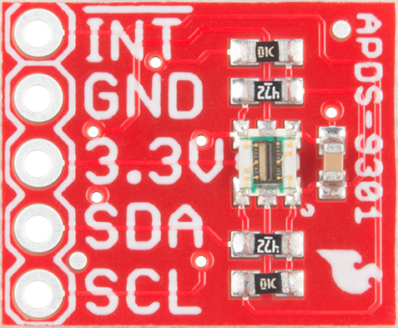
SparkFun Ambient Light Sensor
APDS-9301
https://www.sparkfun.com/products/14350

Slide 5
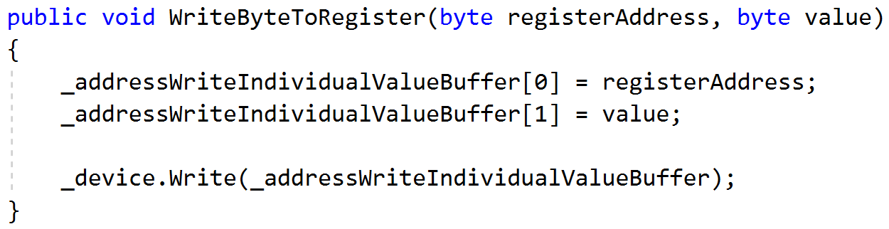
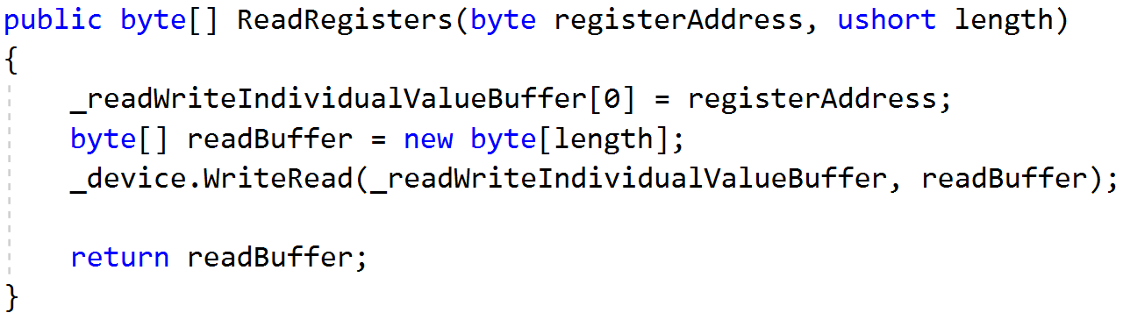
I²C Protocol
Eye Squared See
Synchronous Protocol
Requires Hardware Support
Message Process
Writing Data
Write Out Register
Write Out Each Byte
Reading Data
Write Out Register
Read Each Byte

Slide 6
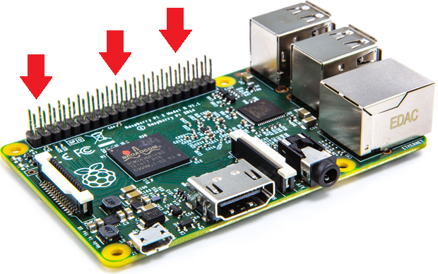
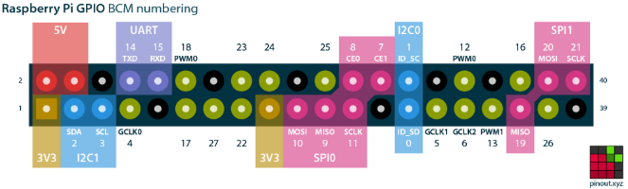
Raspberry Pi
“Low Resources”
1.4 GHz 64 bit ARM CPU
1 GB RAM
Pi 3 B+
Exposed Pins
The Money Maker

Slide 7
Three Options with .NET on Raspberry Pi
Windows 10 IoT
Mono over Linux
.NET Core over Linux

Slide 8
Windows 10 IoT
Version of Windows for non-general purpose devices
Only supports certain chips/boards
Still Windows
PowerShell, command line, .NET, etc

Slide 9
Good
Ugly
Amazing tooling
Top Tier Debugging
Line-by-Line
Remote over network
Familiar to Windows Devs
Remote PowerShell, Command Line
Free OS if no screen
Or screen under 10”
Required OS updates every few years
Enterprise Programming Model
Service vs. Client
Headed vs. Headless
No quick start templates built into VS

Slide 10
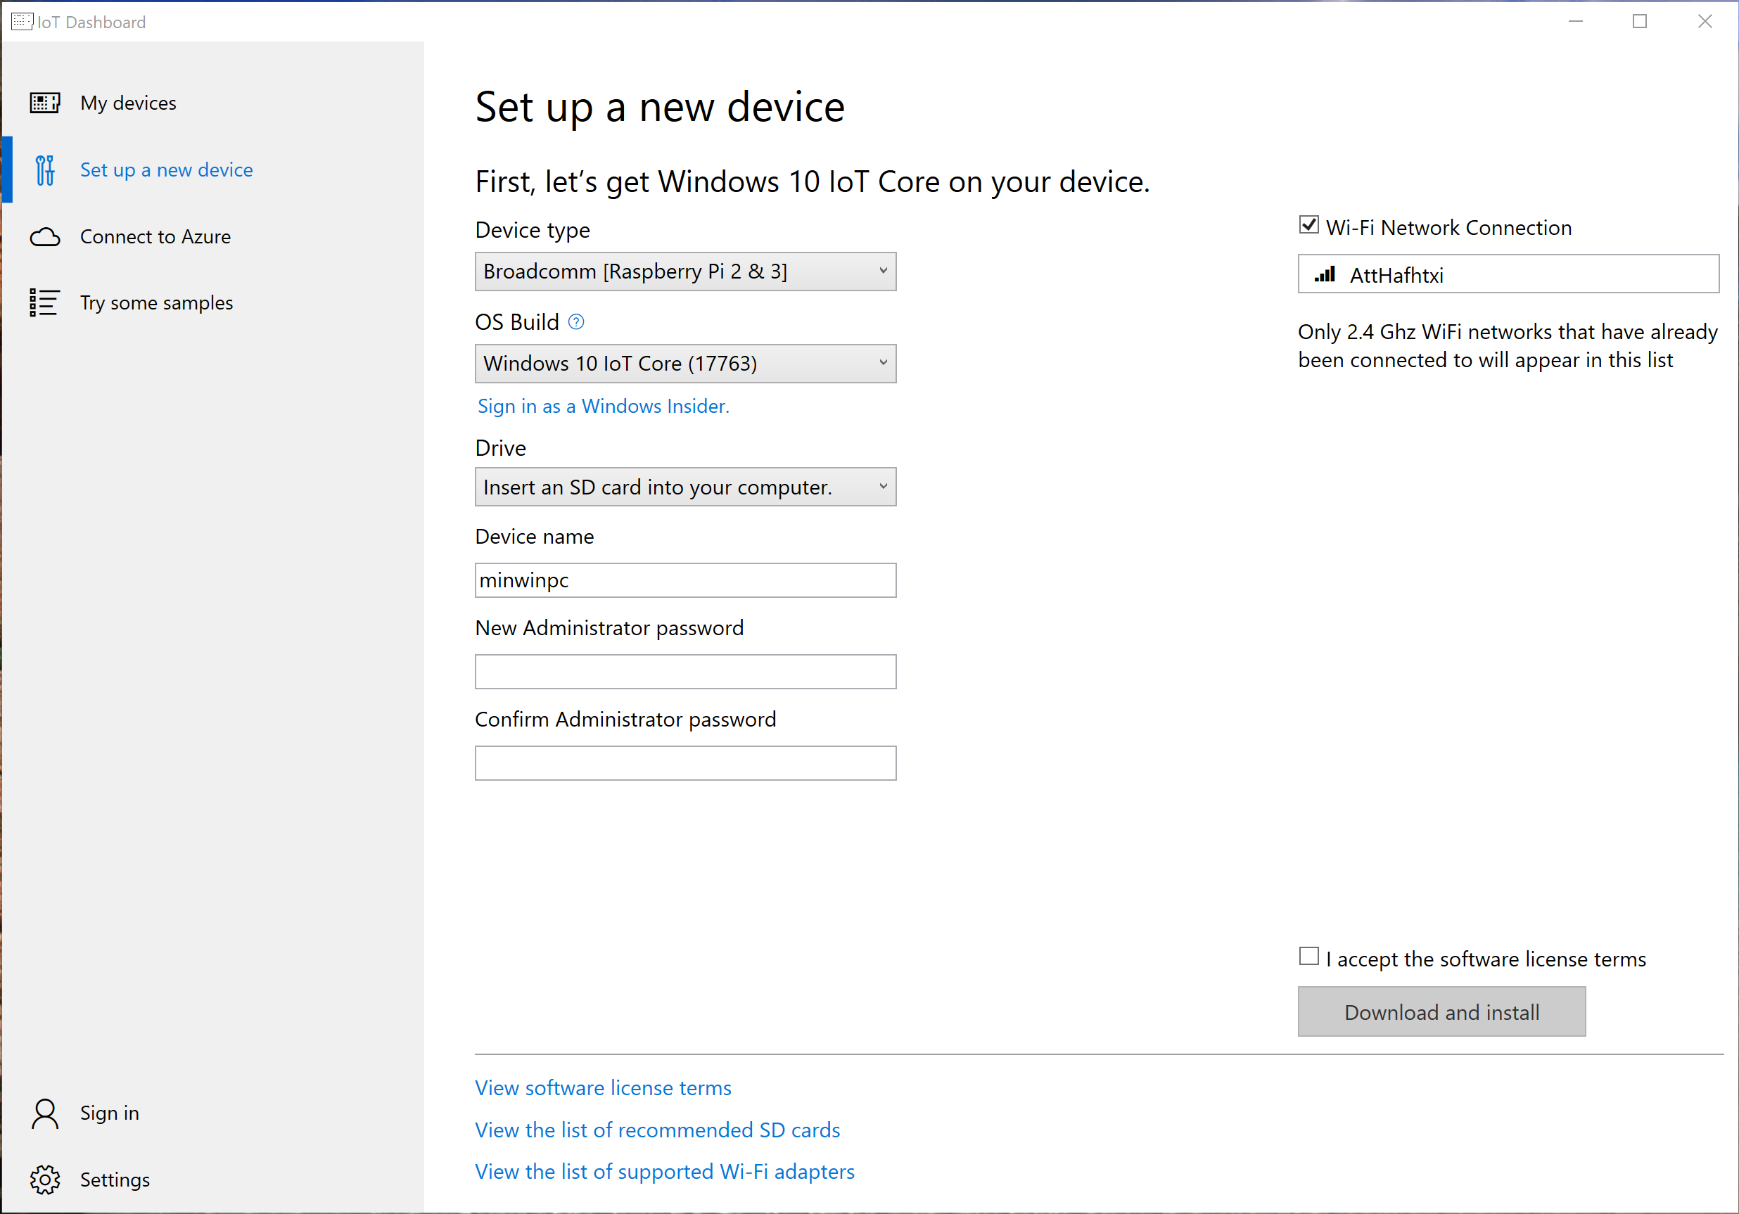
IoT Dashboard
Handles downloading Windows Versions
Puts Windows IoT onto SD Cards
Remotely connects to IoT Devices
Run commands

Slide 11
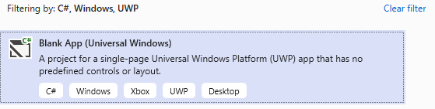
Windows 10 IoT - Getting Setup
Download/Install IoT Core Dashboard
https://docs.microsoft.com/en-us/windows/iot-core/downloads
Create New Project in VS
Install extension for new project templates
https://marketplace.visualstudio.com/items?itemName=MicrosoftIoT.WindowsIoTCoreProjectTemplatesforVS15
Debug Remotely
VS can find the target device

Slide 12
.NET on Raspberry Pi
Running on Linux
Mono vs .NET Core (Pre/Post 3.0)

Slide 13
Good
Mono
Ugly
Access to all Linux tools you’re used to
Mono tools not in .NET Core
Compile on-board
AOT Compiling
.NET Standard
On-board debugging
Installed with apt-get
Windows/MacOS/Linux Support
Doesn’t feel as loved as .NET Core
Performance

Slide 14
Good
.NET Core
Ugly
Remote Debugging Exists
Access to all Linux tools you’re used to
GPIO Support for Raspberry Pi in .NET Core 3.0
Remote Debugging is Slow
Only on VS Code
Can’t compile on ARM chips

Slide 15
Pin Access on Linux
File API
Linux loves File APIs
Not available for all pins like I²C
P/Invoke
For performance
Requires low-level code

Slide 16
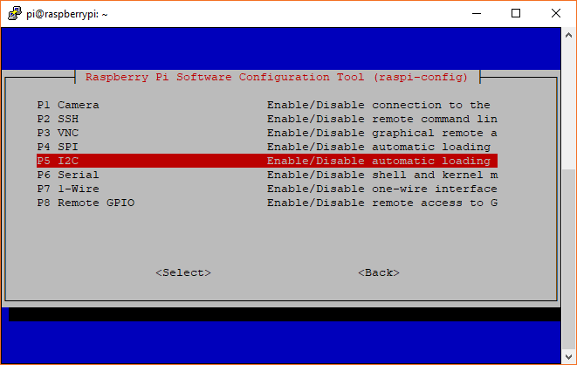
Setting Up I²C Raspberry Pi Linux
Not on by default
Run `sudo raspi-config` to begin setup
https://learn.sparkfun.com/tutorials/raspberry-pi-spi-and-i2c-tutorial/all

Slide 17
Compiling Apps
.NET Core
Specify `linux-arm` architecture
Self Contained if you desire
Can’t be done on ARM device
`dotnet publish ./RaspbianNetCoreDemo -c Release -r linux-arm --self-contained`
~\bin\Release\netcoreapp3.0\linux-arm\publish
`dotnet RaspbianNetCoreDemo .dll`
Mono
Can be done on ARM device
Compile with MonoDevelop on Linux
`mono RaspbianNetCoreDemo.exe`

Slide 18
Code Review

Slide 19
New in .NET Core 3.0
ARM 64 support for Linux
Pin Bindings for Raspberry Pi
Open Source at github.com/dotnet/iot
Installed with Snap
An app package manager
sudo apt install snapd
sudo snap install dotnet-sdk --beta --classic

Slide 20
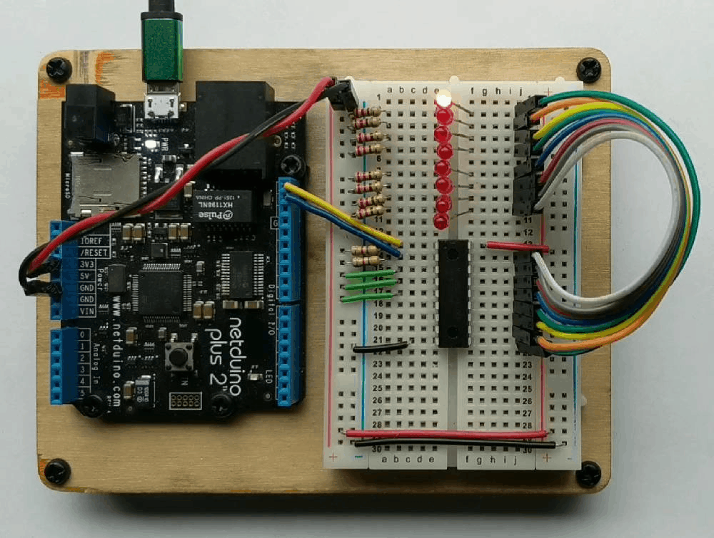
History Lesson - .NET MicroFramework
No More Active Development
Designed for MCUs
RAM ~300KB
CPU like Cortex-M3 @ 120 MHz
Open Source
http://netmf.github.io/
Netduino 2 courtesy of https://www.wildernesslabs.co/

Slide 21
Cons
Limited Language Feature Support
No Generics
Limited MCU Selection
Required VS Extension to begin
Only worked on Community Version of VS
Maxed out at VS 2015

Slide 22
TinyCLR OS
Created by GHI Electronics
https://www.ghielectronics.com/tinyclr/features
Can be ported to custom hardware
Modules hosted on NuGet
Not open source
Though documentation is
Supports native C/C++ code
No Generics Support

Slide 23
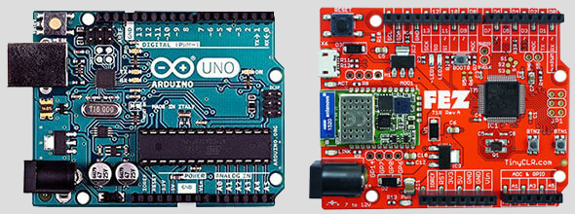
FEZ Board
Fast and Easy
Arduino Pin Compatible
$10 – Lowest Price
ARM Cortex-M4
512 KByte flash
96 KByte SRAM

Slide 24
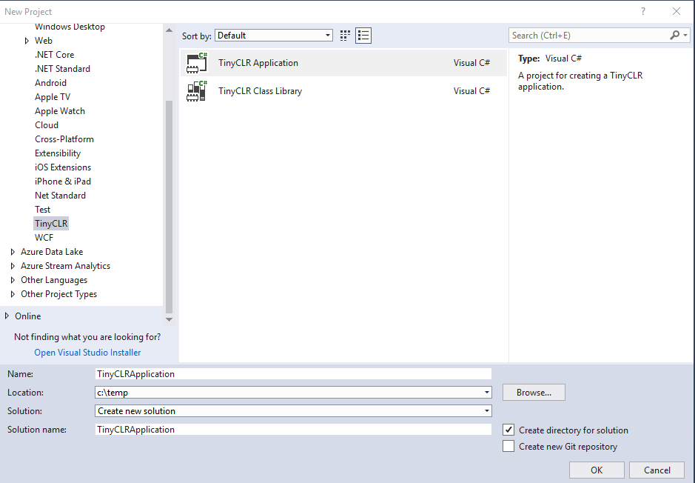
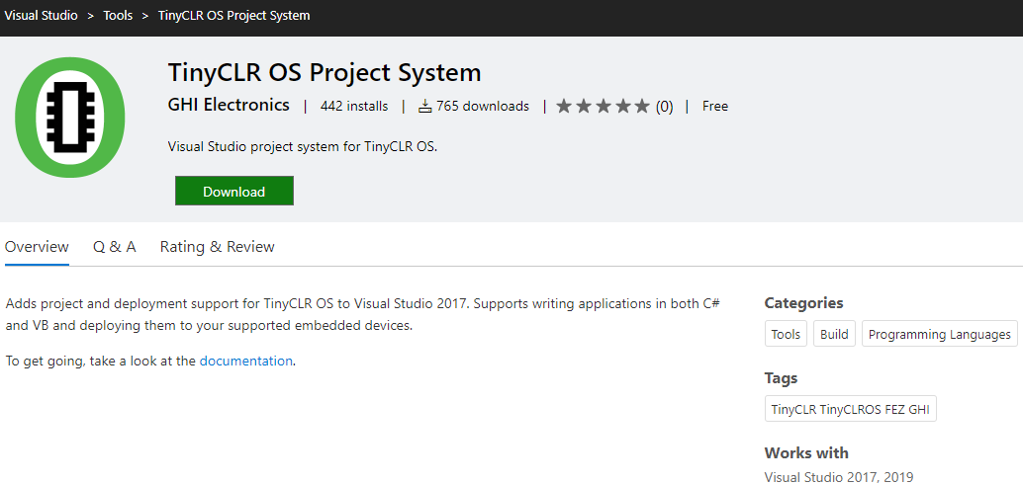
TinyCLR OS – Getting Setup
Follow simple instructions online
https://docs.ghielectronics.com/software/tinyclr/getting-started.html
Install “TinyCLR OS Project System” Extension to VS
https://marketplace.visualstudio.com/items?itemName=ghielectronics.tinyclr-projectsystem
Create new project

Slide 25
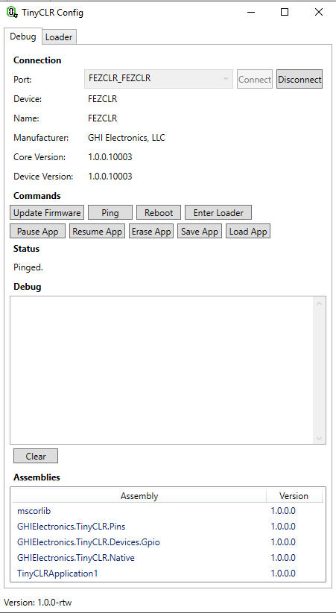
TinyCLR Config
Application to update device Firmware
Debug board
Might need this on first use of new board

Slide 26
Good
Ugly
NuGet Packages
Line-by-Line Debugging
Copies Win10 IoT API
No Generics Support
Can’t reference .NET Standard Libraries
Use Threads, not Tasks
Closed Source

Slide 27
Code Review

Slide 28
Meadow Board
Created by Wilderness Labs
.NET Standard 2.0
Runs on top of Mono Runtime
No Board -> No Demo
Code is Available!
Documentation: beta-developer.wildernesslabs.co
Very Early Days

Slide 29
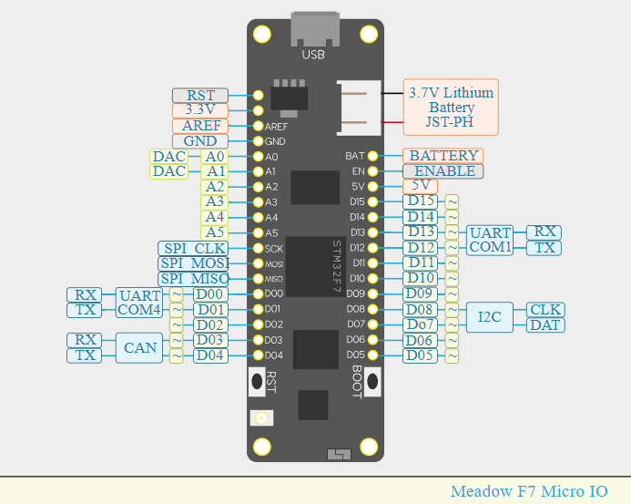

Slide 30
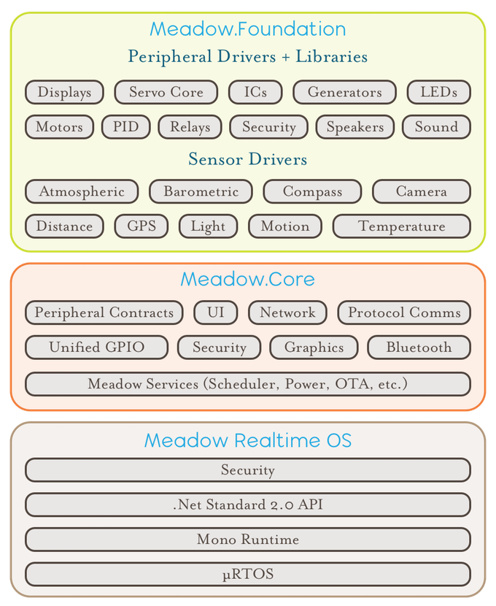

Slide 31
Good
Ugly
NuGet Packages
Line-by-Line Debugging
Windows/MacOS/Linux Support
Very early days
Beta product for now
Connecting over Vagrant VM is very different
Creating .NET Framework App/DLLs feels off

Slide 32
Getting Setup - Dev Machine - Windows
Follow Instructions per OS
Windows, Linux, and MacOS
Install VirtualBox
Install Vagrant
dfu-util*
Used to send Meadow OS and/or Your App to Meadow board
* This util comes with Vagrant setup. Download to your OS if you want to
Downloads Link
http://beta-developer.wildernesslabs.co/guides/Getting_Started/Downloads/index.html

Slide 33
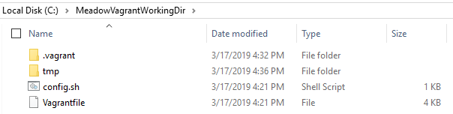
Setup Vagrant
VM software for development machines
After installing, create a Working Folder
Download custom Vagrant file and config.sh from Wilderness Labs
Copy/Paste Vagrantfile and config.sh to Working Folder
From command line, run `vagrant up` to initialize the space

Slide 34
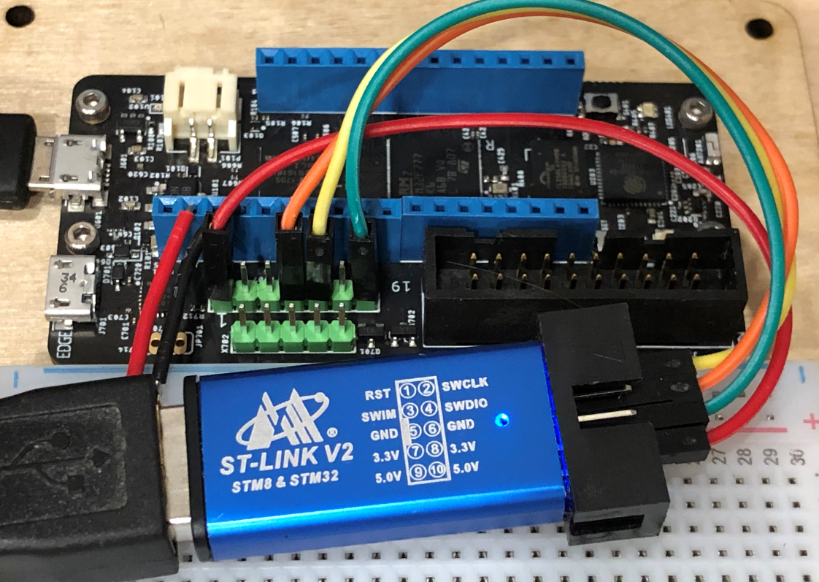
Getting Board Setup
Purchase ST-Link V2
For connecting Meadow board to host computer over USB
Download ST-Link software
Download dfu-util
Device Firmware Upgrade Utilities
Flash Meadow Board with dfu-util

Slide 35
Writing a Meadow App in VS
Create new Console App
.NET Framework 4.7.1
Same on MacOS, just extra steps
Add the Meadow.Core NuGet package
Change assembly name to app
Meadow OS is hard coded to only run ‘app.exe’
Not sure if this is temporary
Create any Class Libraries as .NET Framework
Not Standard

Slide 36
Deploying to/Running On a Meadow Board
Copy/Paste files from /bin to the ~/tmp folder in your Vagrant working folder
Start Vagrant VM
Connect ST-Link to Meadow
Within Vagrant, verify connection to Meadow with `lusb` command
Run `./start.sh &`
Start GDB with `gdb` command
At prompt, enter `target remote :4242`
Enter `c` to start your app.exe

Slide 37
Code Review

Slide 38
Extras
Hastlayer
C# on FPGA
Open Source
https://hastlayer.com
Azure Functions for Edge Computing
Business-logic Azure Function in a Docker Container on Device
IoT Thing

Slide 39
Shameless Self Promotion
@ProgrammerAL
ProgrammerAL.com
Developer Side Quests Podcast
Looking for Guests
Level 34 Pokémon Go Trainer

